Slide 1
Practical Statistics for Data science Review
Exploratory Data Analysis

Slide 2
Chapter 3
Statistical Experiments and Significance Testing

Slide 3
Introduction
Data scientist are faced with the need to conduct continual experiments in order to confirm or reject a hypothesis.
In this chapter we will review traditional experimental design and discuss some common challenges in data science.
Classical Statistical inference Pipeline:
Formulate hypothesis
Design experiment
Collect Data
Inference/ Conclusions

Slide 4
A/B Testing Key terms
An A/B testing is an experiment with two groups to establish which of two treatments, products, procedures, or the like is superior.
Treatment: Something to which a subject is exposed.
Treatment group: A group of subjects exposed to a specific treatment.
Control group: A group of subjects exposed to no treatment (or standard treatment).
Randomization: The process of randomly assigning subjects to treatments.
Subjects: The items that are exposed to treatments.
Test statistic: The metric used to measure the effect of the treatment.

Slide 5
A/B testing examples
Testing two soil treatments to determine which produces better seed germination.
Testing two therapies to determine which suppresses cancer more effectively.
Testing two prices to determine which yields more net profit.
Testing two web headlines to determine which produces more clicks
Testing two web ads to determine which generates more conversions.

Slide 6
A/B Testing
An A/B test has subjects that can be assigned to one treatment or another.
Subjects are randomized to treatments.
Measure:
The effect of the different treatments.
Luck of the draw in which subjects are assigned to which treatments.
Pay attention to the test statistic or metric you use to compare group A to group B.

Slide 7
A/B testing
Why have a control group?
Why just A/B? Why not C, D, …?

Slide 8
A/B testing
Why have a control group?
Without a control group, there is no assurance that “other things are equal” and that any difference is really due to the treatment or to chance.
Why just A/B? Why not C, D, …?
Additional treatments can be included.
Subjects might have repeated measurements.
This method is commonly applied in areas where subjects are scarce, expensive and acquired over time. So the designs have multiple opportunities to stop the experiment and reach conclusions.

Slide 9
Hypothesis test key terms
Also called significance test. Their purpose is to help you learn whether random chance might be responsible for an observed effect.
Null hypothesis. The hypothesis that chance is to blame.
Alternative hypothesis: counterpoint to the null (what you hope to prove).
One-way test: Hypothesis test that counts chance results only in one direction
Two-way test: Hypothesis test that counts chance results in two directions.

Slide 10

Hypothesis Test Example
Is it true that vitamin C has the ability to cure or prevent the common cold? Or is it just a myth? There's nothing like an in-depth experiment to get to the bottom of it all.

Slide 11

Hypothesis Test Example
Null hypothesis - Children who take vitamin C are no less likely to become ill during flu season.
Alternative hypothesis - Children who take vitamin C are less likely to become ill during flu season.

Slide 12
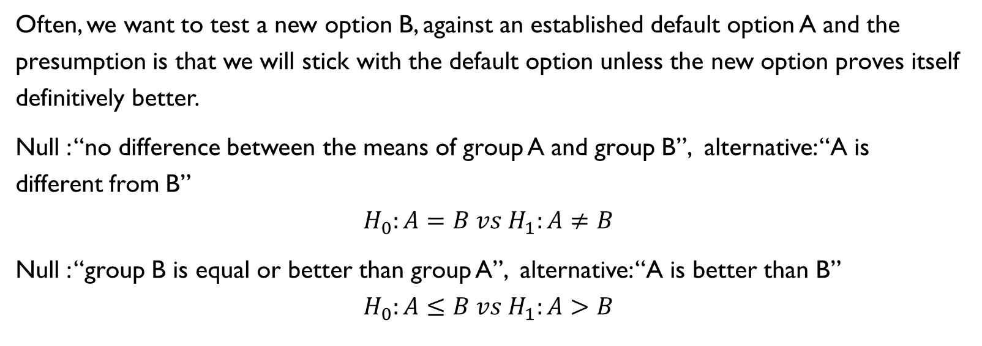
One-way, two-way Hypothesis test
Often, we want to test a new option B, against an established default option A and the presumption is that we will stick with the default option unless the new option proves itself definitively better.
Null : “no difference between the means of group A and group B”, alternative: “A is different from B”
$$H_{0}:A=B vs H_{1}:A≠B$$
Null : “group B is equal or better than group A”, alternative: “A is better than B”
$$H_{0}:A≤B vs H_{1}:A>B$$

Slide 13

Permutation test
Procedure of combining two or more samples together, and randomly (or exhaustively) reallocating the observations to resamples.
Combine results from different groups in a single data set.
Shuffle and draw without replacement a resample of group A size.
From the remaining, draw without replacement a resample of group B size.
Do the same for groups C,D (if necessary)
Calculate test statistic for the resamples, and record (one iteration)
Repeat R time to yield a permutation distribution of the test statistic
Go back to the observed difference between group and compare it to the set of permuted differences.

Slide 14
Permutation test
Exhaustive permutation test: instead of just randomly shuffling and dividing the data, we actually figure out all passible ways it could be divided. With a large number of repeated shufflings, the random permutation test results approximate those of the exhaustive permutation test.
Bootstrap permutation test: The .0draws in steps 2 and 3 are made with replacement.

Slide 15
Statistical significance and P-values
Statistical significance is how statisticians measure whether an experiment (or even a study of existing data) yields a results more extreme than what chance might produce.
If the result is beyond the realm of chance variation , it is said to be statistically significant.
P-value: Given a chance model that embodies the null hypothesis, the p-value is the probability of obtaining results as unusual or extreme as the observed results.
Alpha: The probability threshold of unusualness that chance results must surpass, for actual outcomes to be deemed statically significant.

Slide 16
example

Slide 17
Error types

